Slide 1
Dr. Yifeng Zhu Electrical and Computer Engineering University of Maine
Embedded Systems with ARM Cortex-M Microcontrollers in Assembly Language and C
Chapter 10
Preserve Environment via Stack
Spring 2018

Slide 2
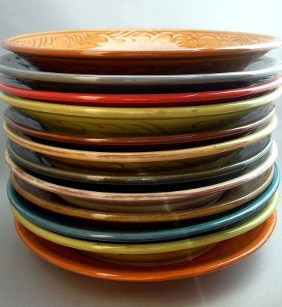
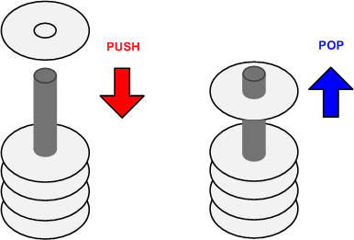
Stack
A Last-In-First-Out data structure
Only allow to access the most recently added item
Also called the top of the stack
Key operations:
push (add item to stack)
pop (remove top item from stack)

Slide 3
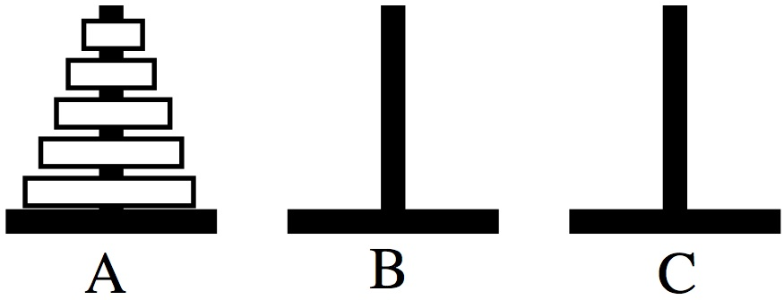
Tower of Hanoi
Only one disk may be moved at a time.
Each move consists of taking the upper disk from one of the rods and sliding it onto another rod, on top of the other disks that may already be present on that rod.
No disk may be placed on top of a smaller disk.

Slide 4
Tower of Hanoi
STACK: Last In First Out
Stack 1
Stack 2
Stack 3
http://en.wikipedia.org/wiki/File:Tower_of_Hanoi_4.gif

Slide 5
Stack Growth Convention: Ascending vs Descending
Descending stack: Stack grows towards low memory address
Ascending stack: Stack grows towards high memory address

Slide 6
Stack Growth Convention: Full vs Empty
Full stack: SP points to the last item pushed onto the stack
Empty stack: SP points to the next free space on the stack

Slide 7
Cortex-M Stack
stack pointer (SP) = R13
Cortex-M uses full descending stack
stack pointer
decremented on PUSH
incremented on POP
SP starts at 0x20000200 for STM32-Discovery

Slide 8
Full Descending Stack

Slide 9
Stack Implementation
Stock Name | Push |  | Pop
 | Equivalent | Alternative | Equivalent | Alternative
Full Descending(FD) | STMFD SP!,list | STMDB SP!,list | LDMFD SP!,list | LDMIA SP!,list
Empty Descending(ED) | STMED SP!,list | STMDA SP!,list | LDMED SP!,list | LDMIB SP!,list
Full Ascending(FA) | STMFA SP!,list | STMIB SP!,list | LDMFA SP!,list | LDMDA SP!,list
Empty Ascending(EA) | STMEA SP!,list | STMIA SP!,list | LDMEA SP!,list | LDMDB SP!,list

Slide 10
Stack
PUSH {Rd}
SP = SP-4 ⟶ descending stack
(*SP) = Rd ⟶ full stack
Push multiple registers
They are equivalent.
PUSH {r8}
PUSH {r7}
PUSH {r6}
PUSH {r6, r7, r8}
PUSH {r8, r7, r6}
The order in which registers listed in the register list does not matter.
When pushing multiple registers, these registers are automatically sorted by name and the lowest-numbered register is stored to the lowest memory address, i.e. is stored last.

Slide 11
Stack
POP {Rd}
Rd = (*SP) ⟶ full stack
SP = SP + 4 ⟶ Stack shrinks
Push multiple registers
They are equivalent.
POP {r6}
POP {r7}
POP {r8}
POP {r6, r7, r8}
POP {r8, r7, r6}
The order in which registers listed in the register list does not matter.
When popping multiple registers, these registers are automatically sorted by name and the lowest-numbered register is loaded from the lowest memory address, i.e. is loaded first.

Slide 12
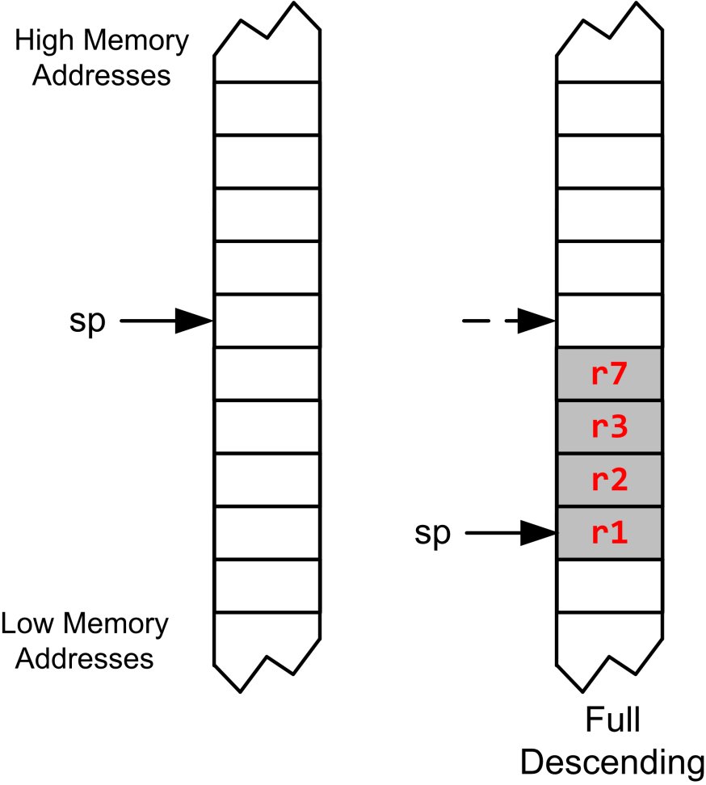
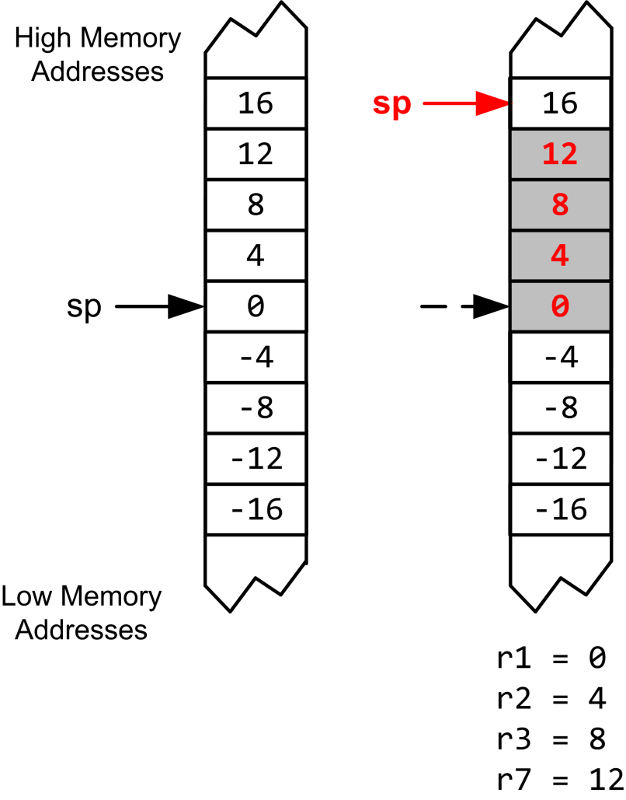
Full Descending Stack
PUSH {r3, r1, r7, r2}
POP {r3, r1, r7, r2}

Slide 13
Stack
PUSH {r3, r1, r7, r2}
POP {r3, r1, r7, r2}

Slide 14
Stack
PUSH {r3, r1, r7, r2}
POP {r3, r1, r7, r2}

Slide 15
Example: swap R1 & R2
R1
0x11111111
R2
0x22222222
PUSH {R1}
PUSH {R2}
POP {R1}
POP {R2}
Address
R13 (SP)
0x20000200
xxxxxxxx
0x20000200
xxxxxxxx
0x200001FC
xxxxxxxx
0x200001F8
memory

Slide 16
Example: swap R1 & R2
R1
0x11111111
R2
0x22222222
PUSH {R1}
PUSH {R2}
POP {R1}
POP {R2}
Address
PC
R13 (SP)
0x200001FC
xxxxxxxx
0x20000200
0x11111111
0x200001FC
xxxxxxxx
0x200001F8
memory

Slide 17
Example: swap R1 & R2
R1
0x11111111
R2
0x22222222
PUSH {R1}
PUSH {R2}
POP {R1}
POP {R2}
Address
R13 (SP)
0x200001F8
PC
xxxxxxxx
0x20000200
0x11111111
0x200001FC
0x22222222
0x200001F8
memory

Slide 18
Example: swap R1 & R2
R1
0x22222222
R2
0x22222222
PUSH {R1}
PUSH {R2}
POP {R1}
POP {R2}
Address
R13 (SP)
0x200001FC
xxxxxxxx
0x20000200
PC
0x11111111
0x200001FC
0x22222222
0x200001F8
memory

Slide 19
Example: swap R1 & R2
R1
0x22222222
R2
0x11111111
PUSH {R1}
PUSH {R2}
POP {R1}
POP {R2}
Address
R13 (SP)
0x20000200
xxxxxxxx
0x20000200
0x11111111
0x200001FC
PC
0x22222222
0x200001F8
memory

Slide 20
Quiz
Are the values of R1 and R2 swapped?
PUSH {R1, R2}
POP {R2, R1}
Answer: No.
But you can:
PUSH {R1, R2}
POP {R2}
POP {R1}
or
PUSH {R1}
PUSH {R2}
POP {R1, R2}

Slide 21
Subroutine
A subroutines, also called a function or a procedure,
single-entry, single-exit
Return to caller after it exits
When a subroutine is called, the Link Register (LR) holds the memory address of the next instruction to be executed after the subroutine exits.

Slide 22
Link Register
Link Register (LR) holds the return address of the current subroutine call.

Slide 23
Call a Subroutine
Caller Program | Subroutine/Callee
MOV r4, #100 ... BL foo ... ADD r4, r4, #1 ; r4 = 101, not 11 | foo PROC ... MOV r4, #10 ; foo changes r4 ... BX LR ENDP

Slide 24
Calling a Subroutine
BL label
Step 1: LR = PC + 4
Step 2: PC = label
Notes:
label is name of subroutine
Compiler translates label to memory address
After call, LR holds return address (the instruction following the call)
Caller Program
MOV r4, #100 ... BL foo ...
Subroutine/Callee
foo PROC ... MOV r4, #10 ... BX LR ENDP

Slide 25
Exiting a Subroutine
BX LR
PC = LR
Caller Program
MOV r4, #100 ... BL foo ...
Subroutine/Callee
foo PROC ... MOV r4, #10 ... BX LR ENDP

Slide 26
ARM Procedure Call Standard
Register | Usage | Subroutine Preserved | Notes
r0 | Argument 1 and return value | No | If return has 64 bits, then r0:r1 hold it. If argument 1 has 64 bits, r0:r1 hold it.
r1 | Argument 2 | No
r2 | Argument 3 | No | If the return has 128 bits, r0-r3 hold it.
r3 | Argument 4 | No | If more than 4 arguments, use the stack
r4 | General-purpose V1 | Yes | Variable register 1 holds a local variable.
r5 | General-purpose V2 | Yes | Variable register 2 holds a local variable.
r6 | General-purpose V3 | Yes | Variable register 3 holds a local variable.
r7 | General-purpose V4 | Yes | Variable register 4 holds a local variable.
r8 | General-purpose V5 | YES | Variable register 5 holds a local variable.
r9 | Platform specific/V6 | No | Usage is platform-dependent.
r10 | General-purpose V7 | Yes | Variable register 7 holds a local variable.
r11 | General-purpose V8 | Yes | Variable register 8 holds a local variable.
r12 (IP) | Intra-procedure-call register | No | It holds intermediate values between a procedure and the sub-procedure it calls.
r13 (SP) | Stack pointer | Yes | SP has to be the same after a subroutine has completed.
r14 (LR) | Link register | No | LR does not have to contain the same value after a subroutine has completed.
r15 (PC) | Program counter | N/A | Do not directly change PC

Slide 27
Link Register
Scratch registers, not saved by subroutine. Hold arguments/result
Callee must save them.
Caller expects these values are retained .
Link Register

Slide 28
Preserve Runtime Environment via Stack
Caller Program | Subroutine/Callee
MOV r4, #100 ... BL foo ... ADD r4, r4, #1 ; r4 = 101, not 11 | foo PROC PUSH {r4} ; preserve r4 ... MOV r4, #10 ; foo changes r4 ... POP {r4} ; Recover r4 BX LR ENDP

Slide 29
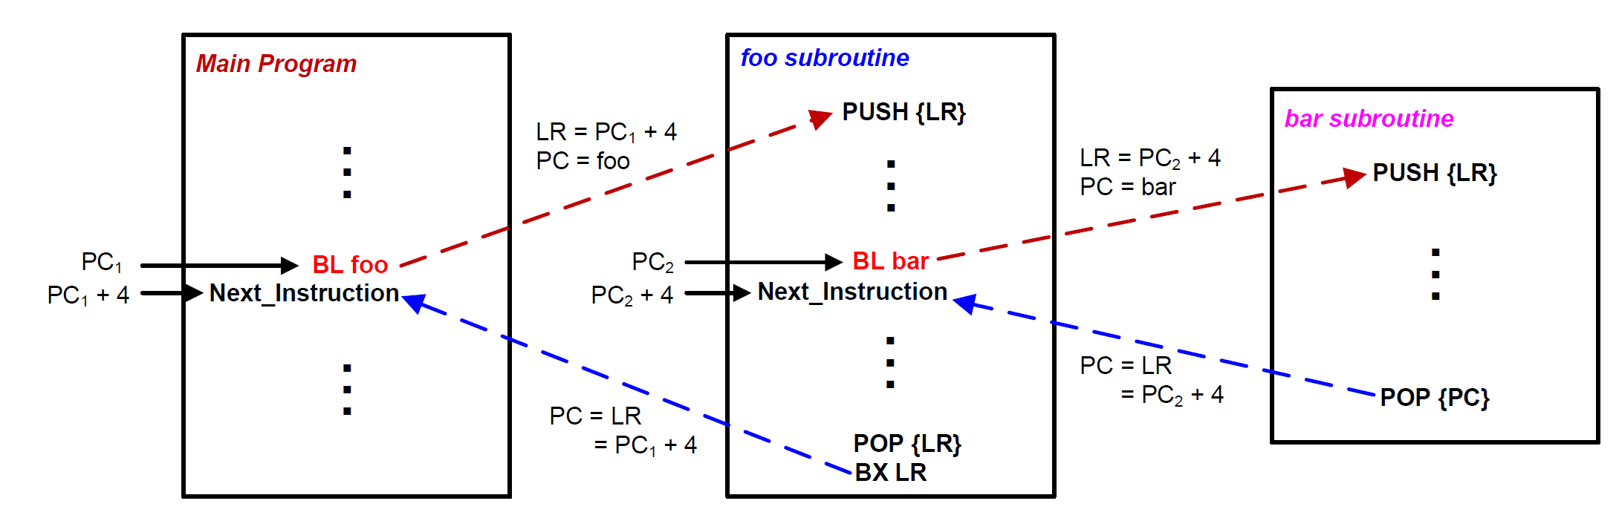
Stacks and Subroutines

Slide 30
Subroutine Calling Another Subroutine
MAIN
MOV R0,#2
BL QUAD
ENDL ...
QUAD PUSH {LR}
BL SQ
BL SQ
POP {LR}
BX LR
SQ MUL R0,R0
BX LR
Function SQ
Function MAIN
Function QUAD

Slide 31
Subroutine Calling Another Subroutine
MAIN PROC
MOV R0,#2
BL QUAD
ENDL ...
ENDP
QUAD PROC
PUSH {LR}
BL SQ
BL SQ
POP {LR}
BX LR
ENDP
SQ PROC
MUL R0,R0
BX LR
ENDP
Function MAIN
Function SQ
Function QUAD

Slide 32
Example: R0 = R0⁴
MOV R0,#2
BL QUAD
B ENDL
SQ MUL R0,R0
BX LR
QUAD PUSH {LR}
BL SQ
BL SQ
POP {LR}
BX LR
ENDL ...
xxxxxxxx
0x20000200
0x200001FC
0x200001F8
R0
MOV R0,#2
0x08000138
BL QUAD
0x0800013C
B ENDL
0x08000140
SP
0x20000200
SQ
MUL R0,R0
0x08000144
LR
BX LR
0x08000148
PC
0x08000138
QUAD
PUSH {LR}
0x0800014C
BL SQ
0x08000150
BL SQ
0x08000154
POP {LR}
0x08000158
BX LR
0x0800015C

Slide 33
Example: R0 = R0⁴
MOV R0,#2
BL QUAD
B ENDL
SQ MUL R0,R0
BX LR
QUAD PUSH {LR}
BL SQ
BL SQ
POP {LR}
BX LR
ENDL ...
xxxxxxxx
0x20000200
0x200001FC
0x200001F8
R0
0x02
MOV R0,#2
0x08000138
BL QUAD
0x0800013C
B ENDL
0x08000140
SP
0x20000200
SQ
MUL R0,R0
0x08000144
LR
BX LR
0x08000148
PC
0x0800013C
QUAD
PUSH {LR}
0x0800014C
BL SQ
0x08000150
BL SQ
0x08000154
POP {LR}
0x08000158
BX LR
0x0800015C

Slide 34
Example: R0 = R0⁴
MOV R0,#2
BL QUAD
B ENDL
SQ MUL R0,R0
BX LR
QUAD PUSH {LR}
BL SQ
BL SQ
POP {LR}
BX LR
ENDL ...
xxxxxxxx
0x20000200
0x200001FC
0x200001F8
R0
0x02
MOV R0,#2
0x08000138
BL QUAD
0x0800013C
B ENDL
0x08000140
SP
0x20000200
SQ
MUL R0,R0
0x08000144
LR
0x08000140
BX LR
0x08000148
PC
0x0800014C
QUAD
PUSH {LR}
0x0800014C
BL SQ
0x08000150
BL SQ
0x08000154
Preserve
Link Register (LR)
POP {LR}
0x08000158
BX LR
0x0800015C

Slide 35
Example: R0 = R0⁴
MOV R0,#2
BL QUAD
B ENDL
SQ MUL R0,R0
BX LR
QUAD PUSH {LR}
BL SQ
BL SQ
POP {LR}
BX LR
ENDL ...
xxxxxxxx
0x20000200
0x08000140
0x200001FC
0x200001F8
R0
0x02
MOV R0,#2
0x08000138
BL QUAD
0x0800013C
B ENDL
0x08000140
SP
0x200001FC
SQ
MUL R0,R0
0x08000144
LR
0x08000140
BX LR
0x08000148
PC
0x08000150
QUAD
PUSH {LR}
0x0800014C
BL SQ
0x08000150
BL SQ
0x08000154
POP {LR}
0x08000158
BX LR
0x0800015C

Slide 36
Example: R0 = R0⁴
MOV R0,#2
BL QUAD
B ENDL
SQ MUL R0,R0
BX LR
QUAD PUSH {LR}
BL SQ
BL SQ
POP {LR}
BX LR
ENDL ...
xxxxxxxx
0x20000200
0x08000140
0x200001FC
0x200001F8
R0
0x02
MOV R0,#2
0x08000138
BL QUAD
0x0800013C
B ENDL
0x08000140
SP
0x200001FC
SQ
MUL R0,R0
0x08000144
LR
0x08000154
BX LR
0x08000148
PC
0x08000144
QUAD
PUSH {LR}
0x0800014C
BL SQ
0x08000150
BL SQ
0x08000154
POP {LR}
0x08000158
BX LR
0x0800015C

Slide 37
Example: R0 = R0⁴
MOV R0,#2
BL QUAD
B ENDL
SQ MUL R0,R0
BX LR
QUAD PUSH {LR}
BL SQ
BL SQ
POP {LR}
BX LR
ENDL ...
xxxxxxxx
0x20000200
0x08000140
0x200001FC
0x200001F8
R0
0x04
MOV R0,#2
0x08000138
BL QUAD
0x0800013C
B ENDL
0x08000140
SP
0x200001FC
SQ
MUL R0,R0
0x08000144
LR
0x08000154
BX LR
0x08000148
PC
0x08000148
QUAD
PUSH {LR}
0x0800014C
BL SQ
0x08000150
BL SQ
0x08000154
POP {LR}
0x08000158
BX LR
0x0800015C

Slide 38
Example: R0 = R0⁴
MOV R0,#2
BL QUAD
B ENDL
SQ MUL R0,R0
BX LR
QUAD PUSH {LR}
BL SQ
BL SQ
POP {LR}
BX LR
ENDL ...
xxxxxxxx
0x20000200
0x08000140
0x200001FC
0x200001F8
R0
0x04
MOV R0,#2
0x08000138
BL QUAD
0x0800013C
B ENDL
0x08000140
SP
0x200001FC
SQ
MUL R0,R0
0x08000144
LR
0x08000154
BX LR
0x08000148
PC
0x08000154
QUAD
PUSH {LR}
0x0800014C
BL SQ
0x08000150
BL SQ
0x08000154
POP {LR}
0x08000158
BX LR
0x0800015C

Slide 39
Example: R0 = R0⁴
MOV R0,#2
BL QUAD
B ENDL
SQ MUL R0,R0
BX LR
QUAD PUSH {LR}
BL SQ
BL SQ
POP {LR}
BX LR
ENDL ...
xxxxxxxx
0x20000200
0x08000140
0x200001FC
0x200001F8
R0
0x04
MOV R0,#2
0x08000138
BL QUAD
0x0800013C
B ENDL
0x08000140
SP
0x200001FC
SQ
MUL R0,R0
0x08000144
LR
0x08000158
BX LR
0x08000148
PC
0x08000144
QUAD
PUSH {LR}
0x0800014C
BL SQ
0x08000150
BL SQ
0x08000154
POP {LR}
0x08000158
BX LR
0x0800015C

Slide 40
Example: R0 = R0⁴
MOV R0,#2
BL QUAD
B ENDL
SQ MUL R0,R0
BX LR
QUAD PUSH {LR}
BL SQ
BL SQ
POP {LR}
BX LR
ENDL ...
xxxxxxxx
0x20000200
0x08000140
0x200001FC
0x200001F8
R0
0x10
MOV R0,#2
0x08000138
BL QUAD
0x0800013C
B ENDL
0x08000140
SP
0x200001FC
SQ
MUL R0,R0
0x08000144
LR
0x08000158
BX LR
0x08000148
PC
0x08000148
QUAD
PUSH {LR}
0x0800014C
BL SQ
0x08000150
BL SQ
0x08000154
POP {LR}
0x08000158
BX LR
0x0800015C

Slide 41
Example: R0 = R0⁴
MOV R0,#2
BL QUAD
B ENDL
SQ MUL R0,R0
BX LR
QUAD PUSH {LR}
BL SQ
BL SQ
POP {LR}
BX LR
ENDL ...
xxxxxxxx
0x20000200
0x08000140
0x200001FC
0x200001F8
R0
0x10
MOV R0,#2
0x08000138
BL QUAD
0x0800013C
B ENDL
0x08000140
SP
0x200001FC
SQ
MUL R0,R0
0x08000144
LR
0x08000158
BX LR
0x08000148
PC
0x08000158
QUAD
PUSH {LR}
0x0800014C
BL SQ
0x08000150
BL SQ
0x08000154
POP {LR}
0x08000158
BX LR
0x0800015C

Slide 42
Example: R0 = R0⁴
MOV R0,#2
BL QUAD
B ENDL
SQ MUL R0,R0
BX LR
QUAD PUSH {LR}
BL SQ
BL SQ
POP {LR}
BX LR
ENDL ...
xxxxxxxx
0x20000200
0x08000140
0x200001FC
0x200001F8
R0
0x10
MOV R0,#2
0x08000138
BL QUAD
0x0800013C
B ENDL
0x08000140
SP
0x20000200
SQ
MUL R0,R0
0x08000144
LR
0x08000140
BX LR
0x08000148
PC
0x0800015C
QUAD
PUSH {LR}
0x0800014C
BL SQ
0x08000150
BL SQ
0x08000154
Recover
Link Register (LR)
POP {LR}
0x08000158
BX LR
0x0800015C

Slide 43
Example: R0 = R0⁴
MOV R0,#2
BL QUAD
B ENDL
SQ MUL R0,R0
BX LR
QUAD PUSH {LR}
BL SQ
BL SQ
POP {LR}
BX LR
ENDL ...
xxxxxxxx
0x20000200
0x08000140
0x200001FC
0x200001F8
R0
0x10
MOV R0,#2
0x08000138
BL QUAD
0x0800013C
B ENDL
0x08000140
SP
0x20000200
SQ
MUL R0,R0
0x08000144
LR
0x08000140
BX LR
0x08000148
PC
0x08000140
QUAD
PUSH {LR}
0x0800014C
BL SQ
0x08000150
BL SQ
0x08000154
POP {LR}
0x08000158
BX LR
0x0800015C

Slide 44
Initializing the stack pointer (SP)
Before using the stack, software has to define stack space and initialize the stack pointer (SP).
The assembly file startup.s defines stack space and initialize SP.

